Slide 1

FLYING WITH CONFIDENCE YOUR JOURNEY BEGINS WITH AIR TRAVEL SAFETY
ANALYZING SAFETY MEASURES: INSIGHTS FROM SHAN AIRLINES
SHANTHIBOOSHAN SUBRAMANIAN
Notes:
To replace this picture, just select and delete it. Then use the Insert Picture icon to replace it with one of your own!

Slide 2
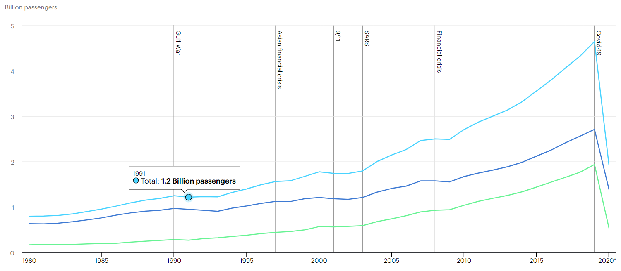

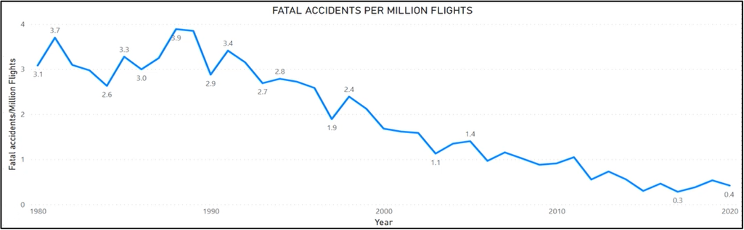
VISUALIZING AIR TRAVEL TRENDS: COMPARATIVE ANALYSIS OF GLOBAL PASSENGER TRAFFIC AND FATAL ACCIDENT RATES
From a significant growth in global air passenger traffic over four decades to a consistent and relatively low rate of fatal accidents per million flights in the United States, this graph encapsulates key trends in air travel evolution and safety

Slide 3
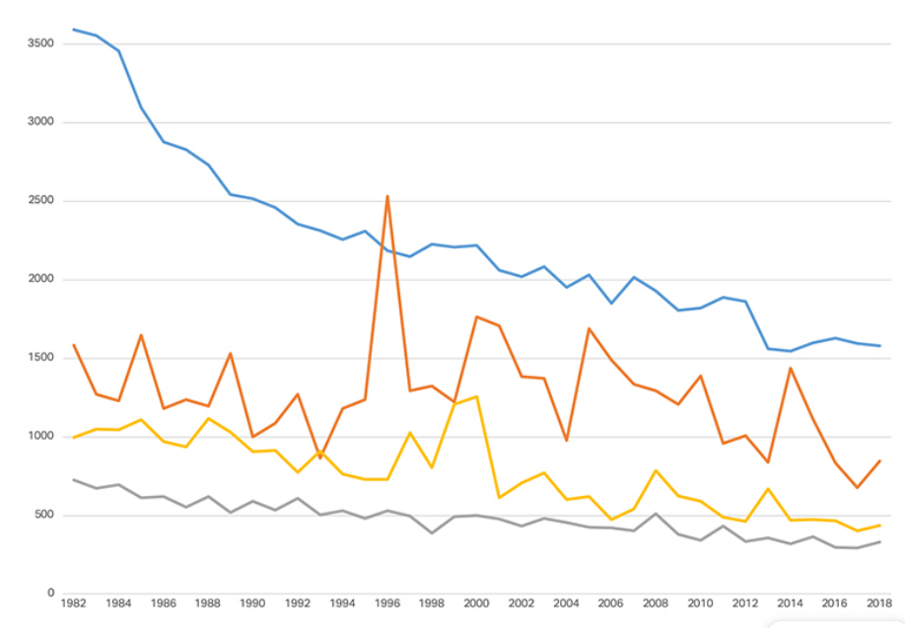
DECADES IN THE SKY: THE EVOLUTION OF AIRCRAFT SAFETY AND AIR TRAVEL
Enhance Air Travel Safety from 3,583 Crashes in 1982 to 1,581 in 2018, Marking a 56% Reduction

Slide 4
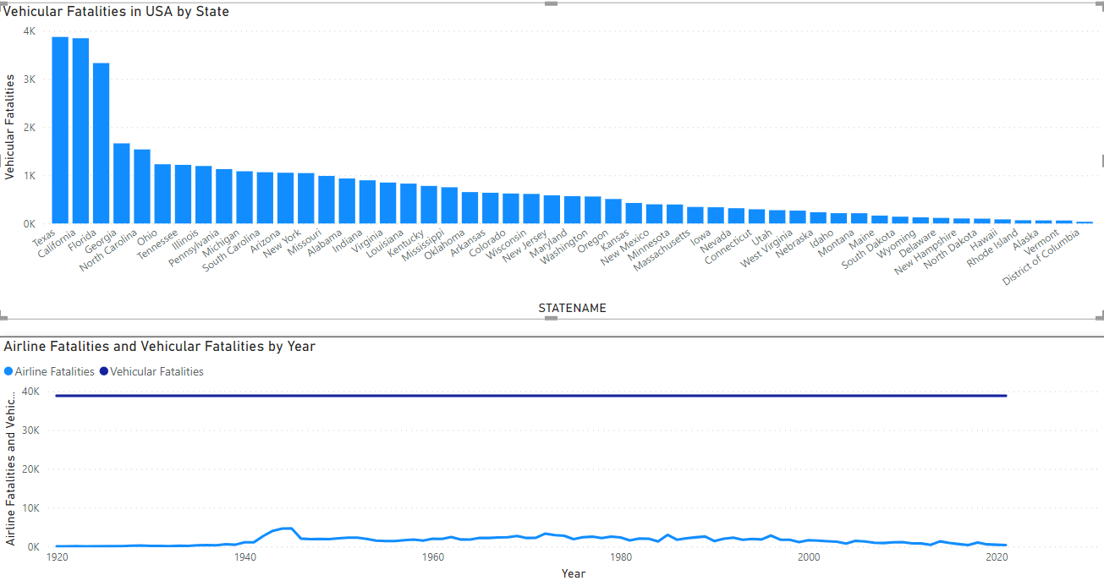
AIR TRAVEL SAFETY: COMPARISON OF AIRLINE AND VEHICULAR FATALITIES OVER TIME
Airline fatalities consistently remain lower than vehicular fatalities, highlighting a significant disparity in safety trends over the unspecified period depicted in the graph

Slide 5
ENSURING AIR TRAVEL SAFETY: CURRENT PRACTISES AND FUTURE TRENDS
Maintenance & training uphold safety.
Tech enhances monitoring.
COVID-19 prompts new protocols.
Compliance & audits ensure standards.
Airports and carriers prioritize security.
Future tech to track and improve safety.

Slide 6


Join us at Shan Airlines, where safety soars high and every passenger's trust is our wingspan
Join us at Shan Airlines, where safety soars high and every passenger's trust is our wingspan
THANK YOU

